Slide 1


Project 3
Devin Fogerty
Demiko Birden
Corey Zwisler
Irfan Ghaffar

Slide 2
Influenza Visualization
Want to visualize the Influenza trends in the US
We will use three forms of visualization:
Bar Chart
Pie Charts
Bubble Chart
Aiming to visualize:
Flu variation by season
Which strain is most dominant
States with most confirmed cases relative to population
Effect of coronavirus lockdowns on influenza rates

Slide 3
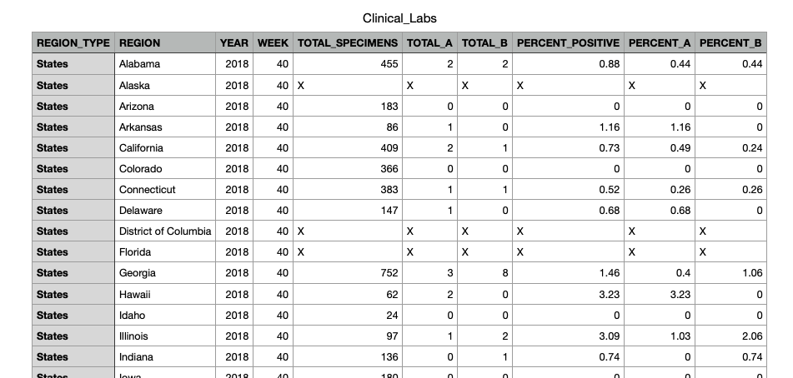
Data
Data extracted from the CDC website
Data from the past five years, from late 2018 to late 2023
All the data was in csv file format

Slide 4
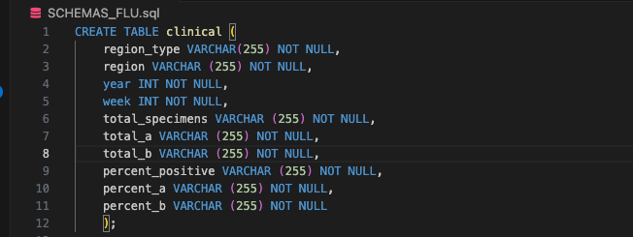
Data Cleanup
SQL used to make tables and import data

Slide 5
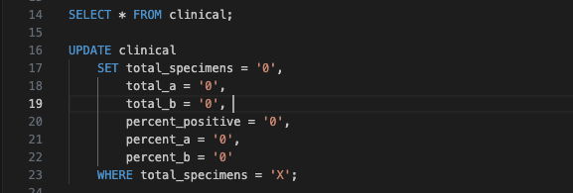
Cleaned up the data using SQL as well
”x’s” were switched to zeros
Removed data for non-states like Puerto Rico, Guam, and the Virgin Islands

Slide 6
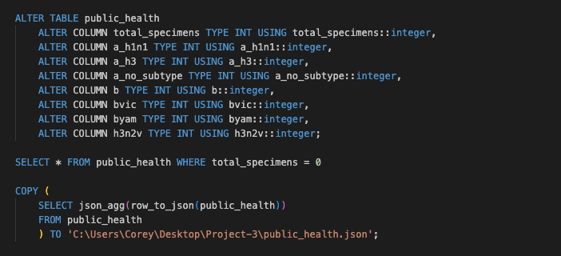

Slide 7
Dashboard Visualization
Extract data to JavaScript as json files
Write JavaScript code to create dashboard for visualization
Live and user interactive dashboard
Filterable by years and states
Dashboard includes
Pie Charts
Bar Chart
Bubble Chart
Info Summary

Slide 8
Any Questions?

Slide 9
Thank you!

